Slide 1
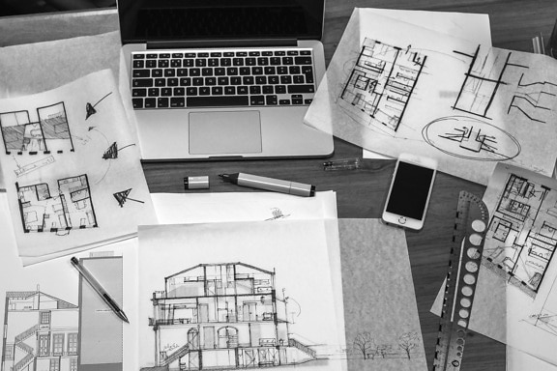
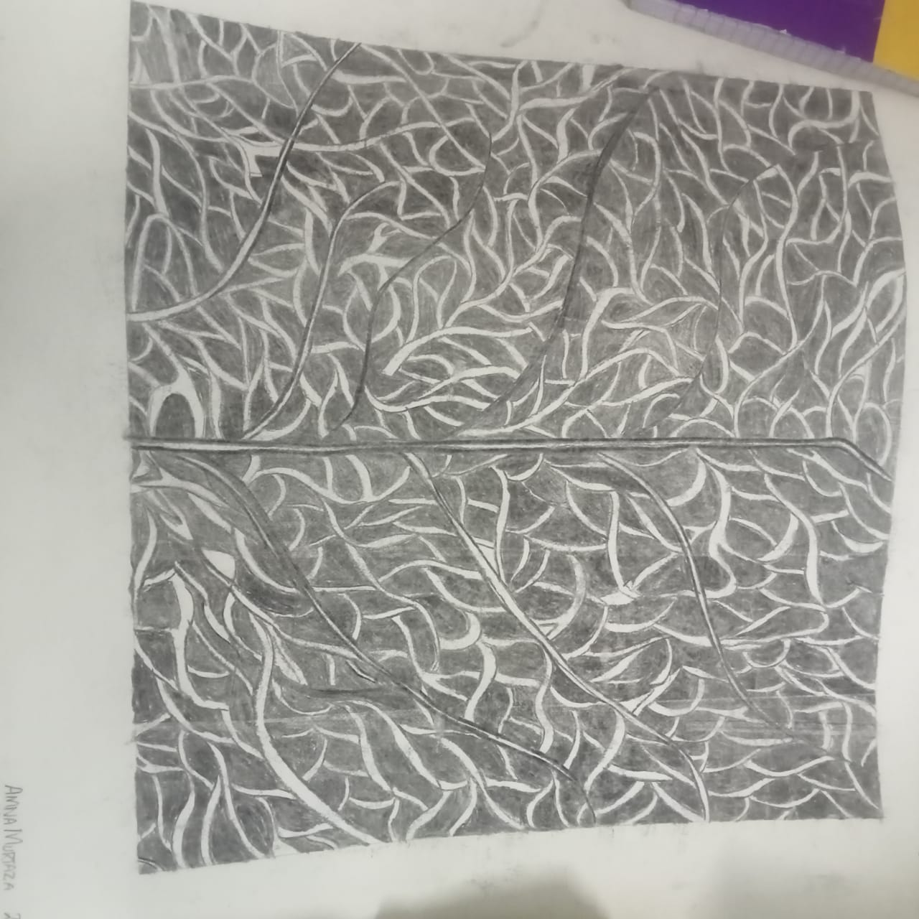
ARCHITECTURE STUDIO WORK

Slide 2
ARCHITECTURE STUDIO WORK
HERE WE WILL SHOW YOU THE STUDIO WORK
We performed work on clay model, on sketches with charcoal.
CLAY MODEL
CARDBOARD MODEL
INTERIOR SKETCHES
INTERIOR SPACES
PLATONIC SOLIDS
These are all involved in our work so have to perform it

Slide 3
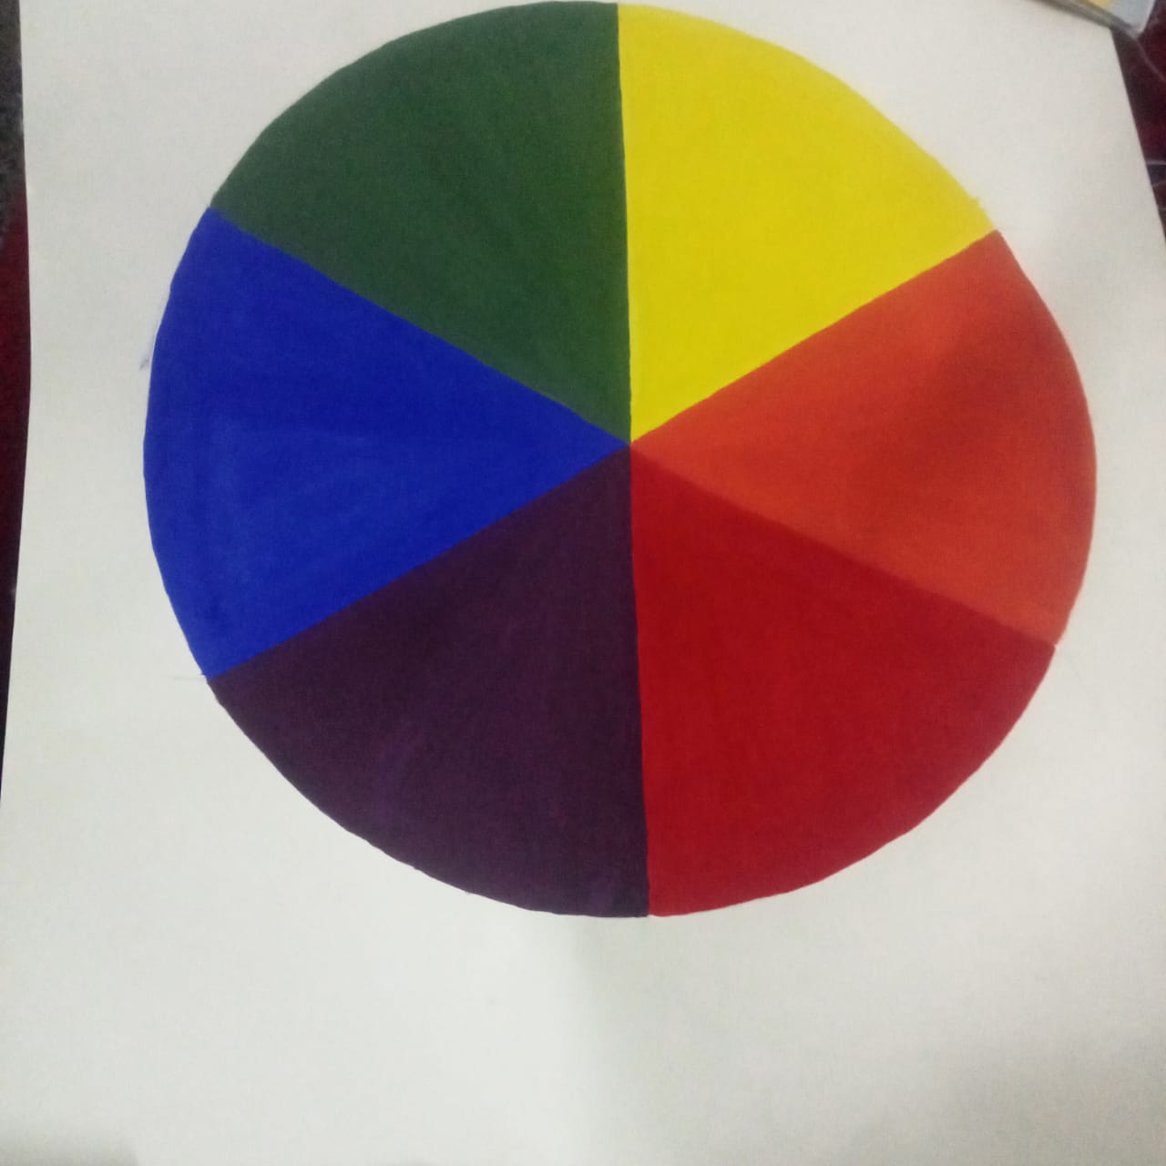
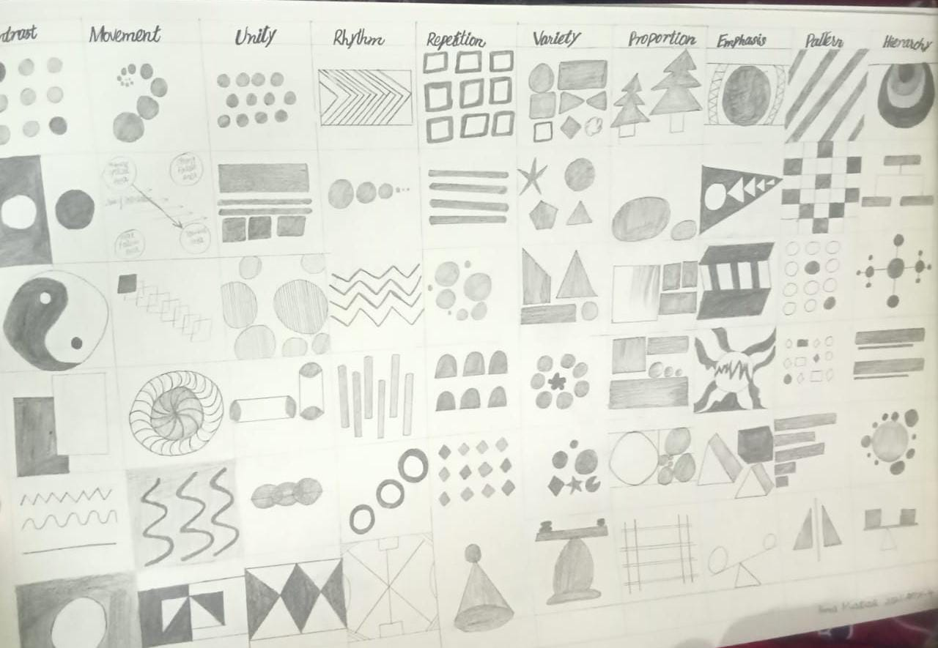
PROJECTS RELATED TO STUDIO WORK
HERE IS THE POSTER COLOUR PROJECT:
This project teaches us how to apply colour gently
How this could be neat
How this could be beautiful
Here the second one represents symbols on
PRINCIPLES OF DESIGN
These designs include
Symmetry
Movement
Pattern
Hierarchy
Rhythem

Slide 4
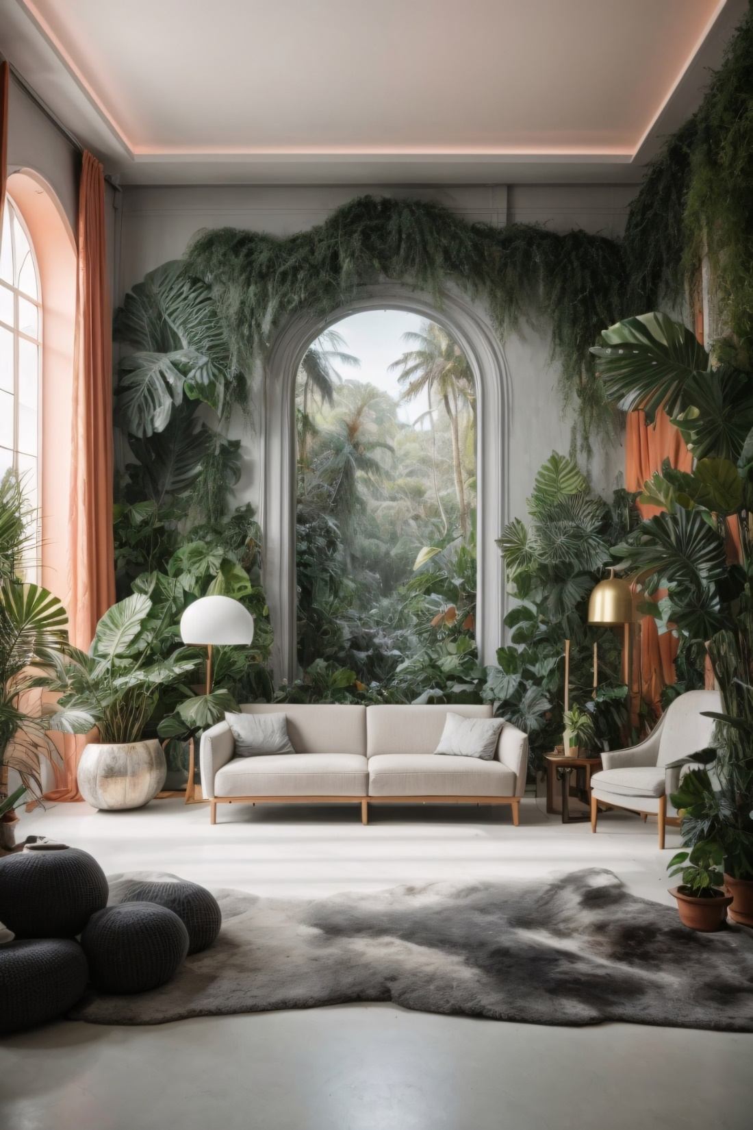
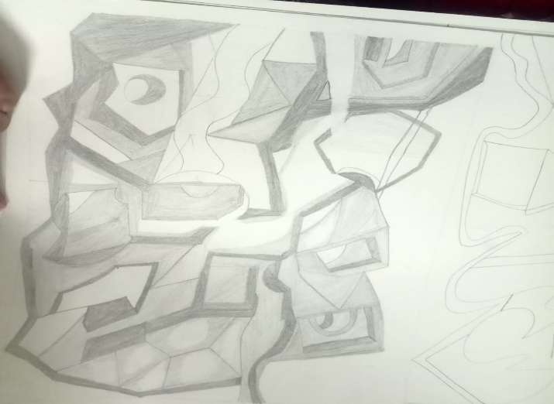
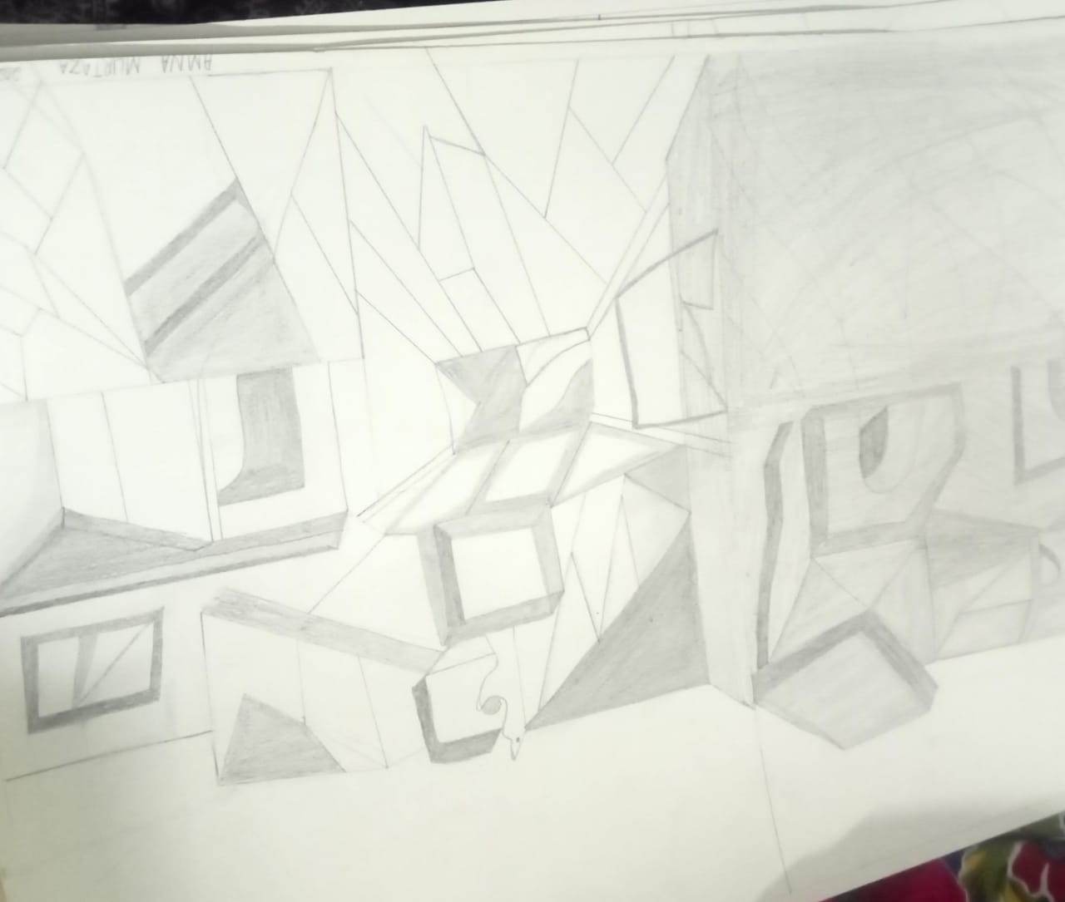
HERE IS THE NEXT PROJECT WHICH IS:
INTERIOR SPACES OF AN ARTIST
Here we have to manage up the spaces by using
Or studying his ideology, his biography, his way of painting
His balance everything which shows consistency with his work.
Then we have to explain its all of
Ideology by showing our spaces
Then we have to create all the work
persistence way

Slide 5
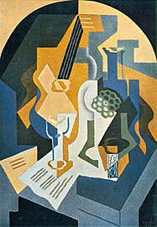
NEXT PROJECT
It is based on cardboard models
This idea would be generated from the spaces we sketch on scolar sheets.
The model is totally 3d it should have inner spaces .
It should be such a specific space for suchj an artist

